Slide 1
Linear Algebra
An Intuitive and Gentle Introduction
Screenshots from 3blue1brown’s animations:
https://www.youtube.com/channel/CSANnvayOd8Ay2scpk91AtpA16FvVqEg_zCZL32hs

Slide 2
Algebra :
« Algebra is the intellectual instrument which has been created for rendering clear the quantitative aspect of the world » — Alfred North Whitehead
Mathematics’s concerns :
Numbers and geometry mainly
Characterized by an extensive use of symbolism:
Generally, the use of these symbols mark the transition between arithmetic and algebra.
Algebra can be understood as a language applied here to lines and objects which go beyond a single dimension (numbers).

Slide 3
Vectors
Fundamental building block for lin. alg.
3 perspectives :
Physics student
Vectors are arrows we can move around
Computer Science student
Vectors are ordered lists of numbers => think of feature vectors
[ 200 sqm, 1.5M] vs. [500K, 150 sqm] => order matters
Math student
Generalizes both of these views

Slide 4
Vectors (2D for now)
What do you think about when someone talks about vectors:
An arrow ?
A set of coordinates/list of numbers ?
An arrow that sits inside a coordinate system, with its tail on the origin => where is the origin ?
What are coordinates ?
Can be seen as a set of instructions to go from the base to the tip of the vector
Go along the x axis a certain amount and then along the y axis a certain amount

Slide 5
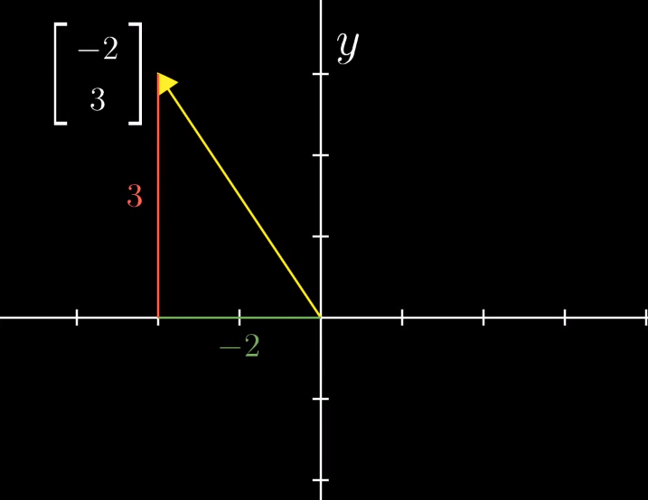

A point’s coordinates are traditionally written horizontally(-2, 3) vs.
Vector coordinates which are vertical with square brackets $\left[\begin{aligned}−2 \\ 3\end{aligned}\right]$

Slide 6
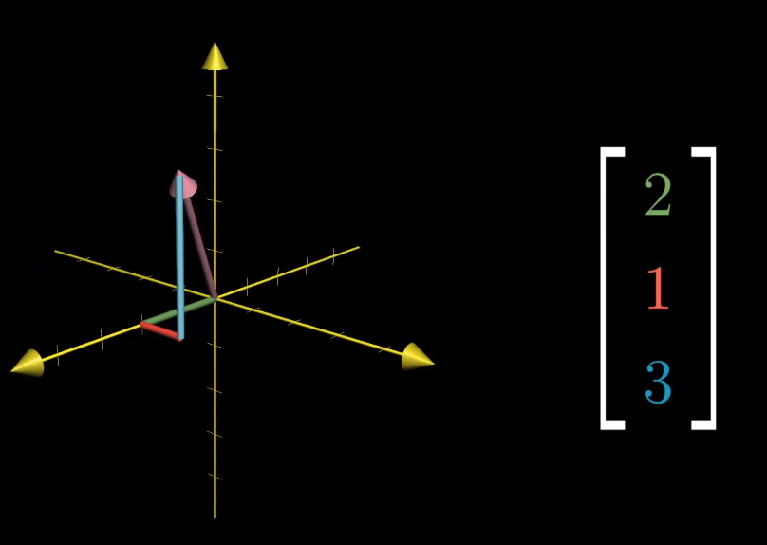
3rd Dimension ?
Ordered Triplet of numbers
Same « instruction » principle
move along the x axis, then parallel to the y axis then parallel to the z axis
Gives you one unique vector in space.

Slide 7
2 Central Operations
Addition
Multiplication
=> What happens when we enter the 2D realm ?

Slide 8
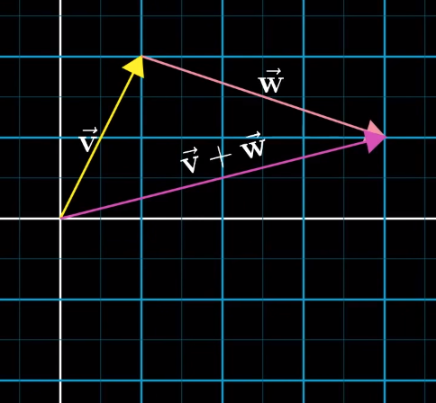
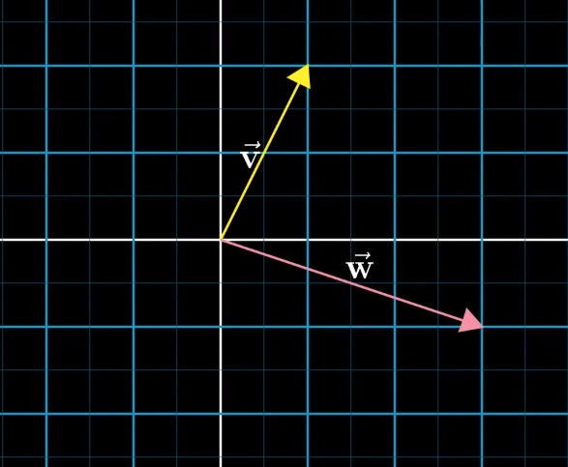
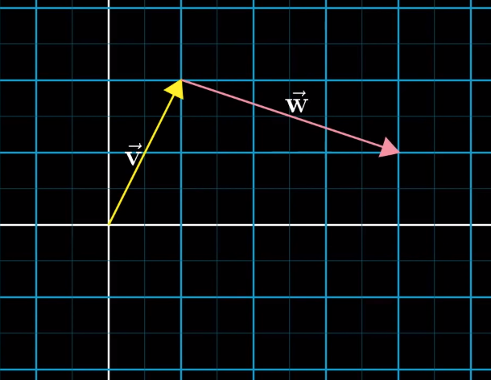
Vector Addition
$$v + w$$

Slide 9
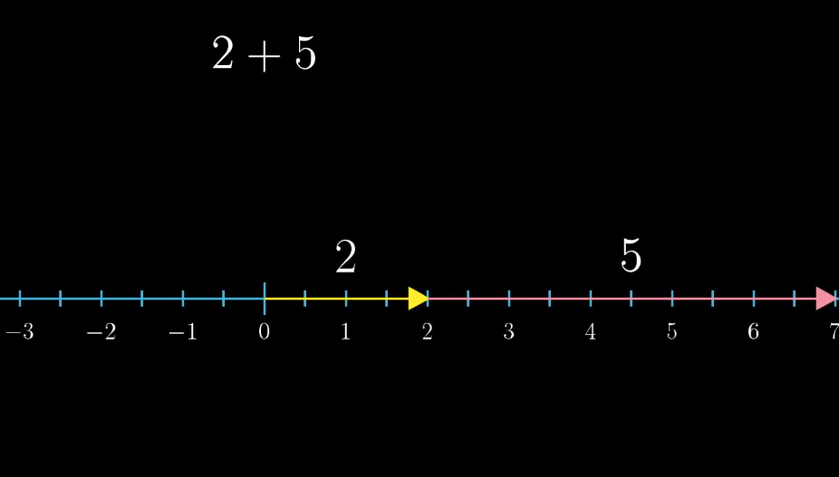
Why this definition of addition ?
Each vector represents a certain movement, a step in a direction
So going along the sum of vectors which starts from the origin takes you exactly to the place where you end up by going along one vector and then the other
Same thing in 1-dimension when adding 2 + 5 for example.

Slide 10
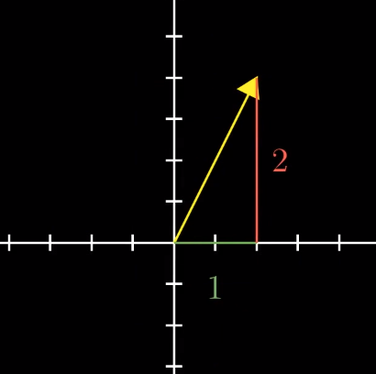
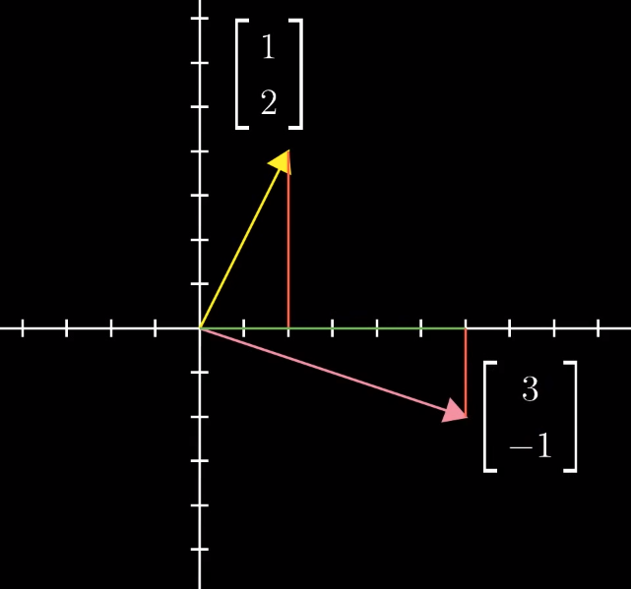
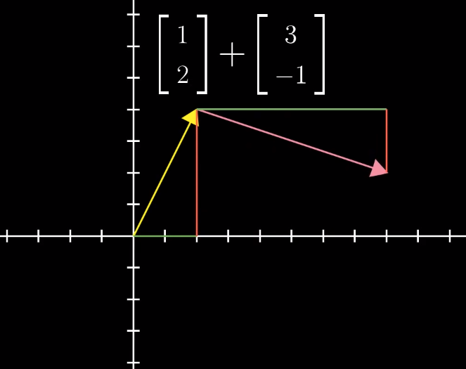
Example
Can think of vector addition as a 4 step path from the origin to the tip of the second vector.

Slide 11
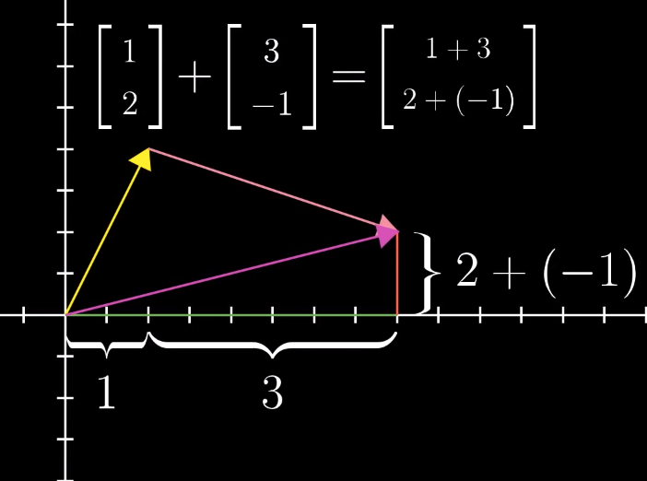
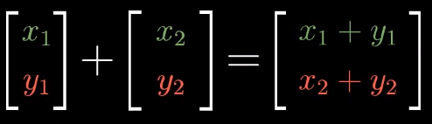
Example and General Formula
This is the same as
moving along the x axis a certain number of steps
and then moving parallel to the y axis for a certain number of steps.

Slide 12
What about substracting one vector from another ?

Slide 13
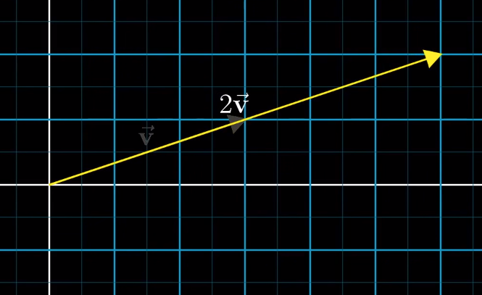
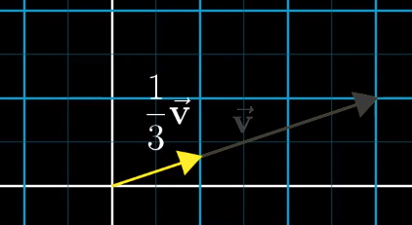
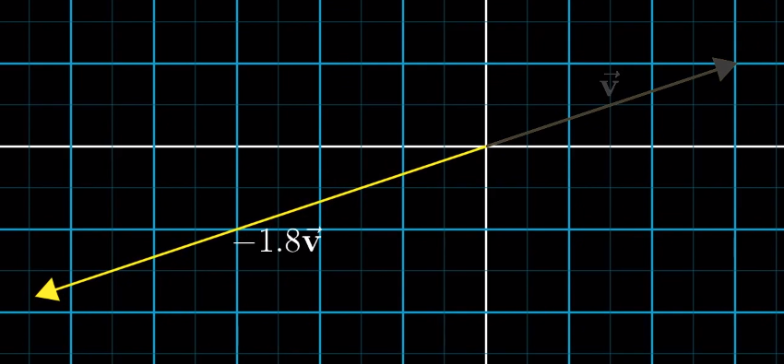
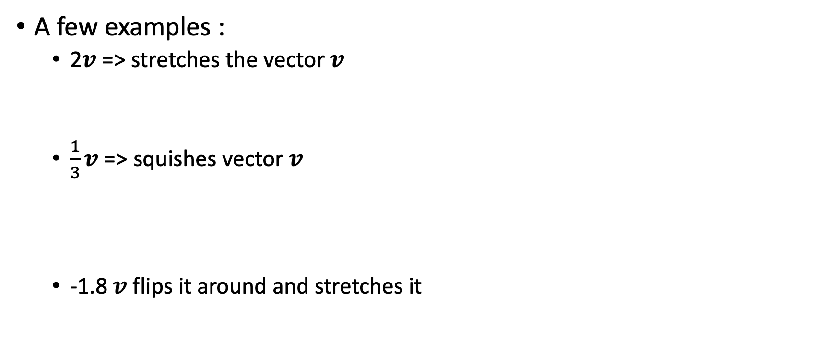
Vector Multiplication
A few examples :
2$v$ => stretches the vector $v$
$\frac{1}{3}v$ => squishes vector $v$
-1.8 $v$ flips it around and stretches it

Slide 14
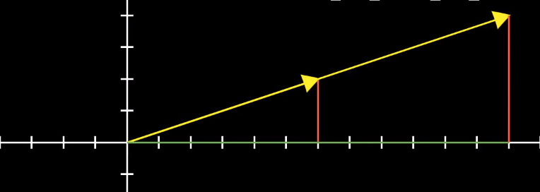


This is called « scaling » a vector
2, -1.8 etc… are also known as « scalars »
General Idea:
$$2\left[\begin{aligned}x \\ y\end{aligned}\right]=\left[\begin{aligned}2x \\ 2y\end{aligned}\right]$$

Slide 15
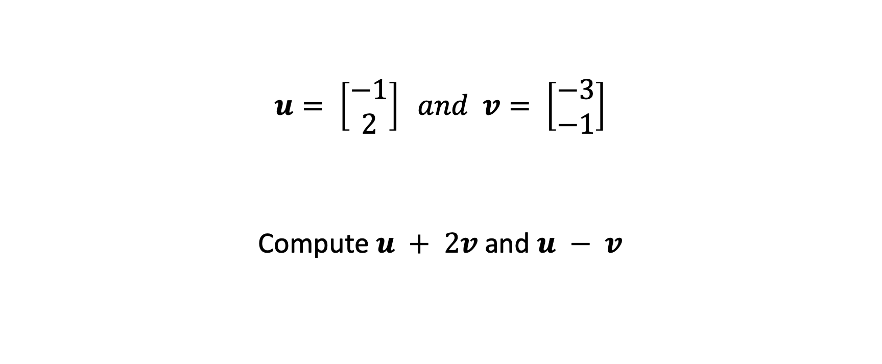
Exercises
$$u= \left[\begin{aligned}−1 \\ 2\end{aligned}\right] and v= \left[\begin{aligned}−3 \\ −1\end{aligned}\right]$$
Compute $u + 2v$and $u − v$

Slide 16
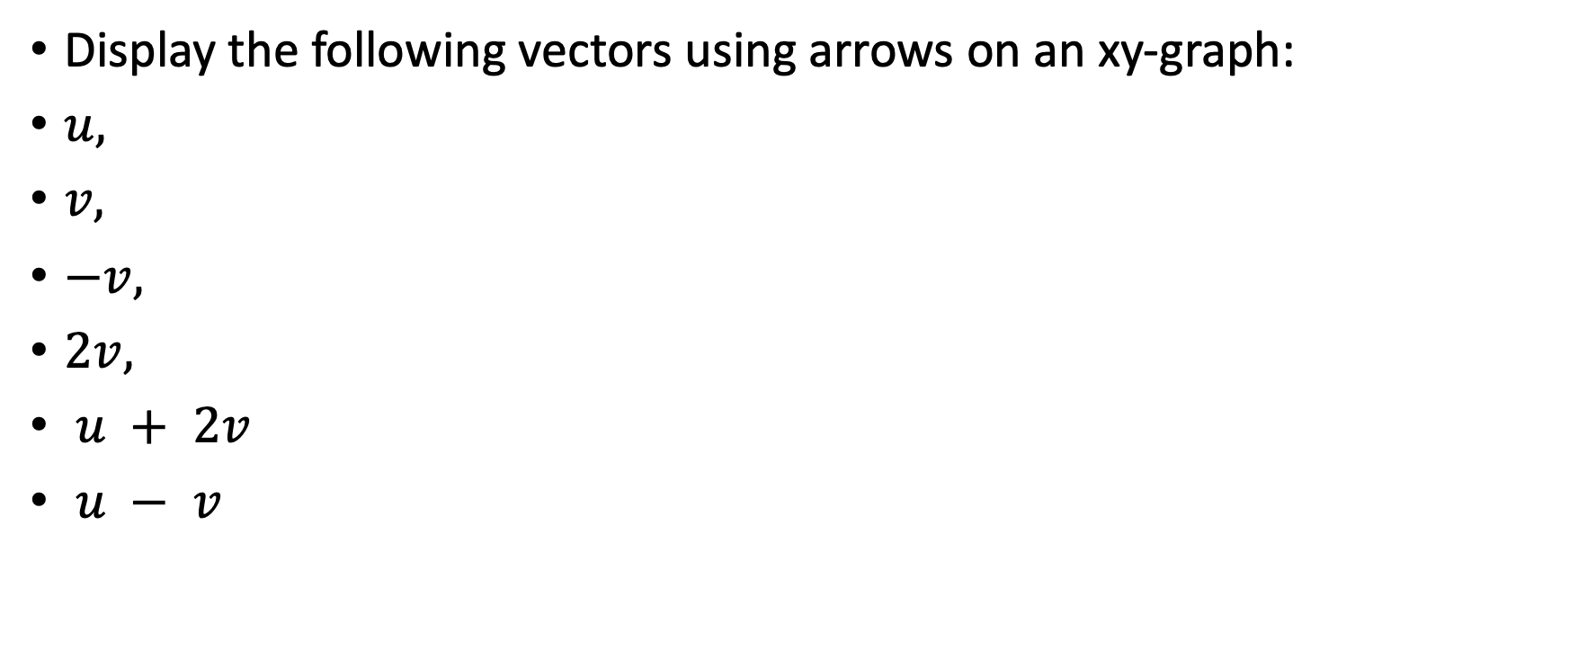
Exercises
Display the following vectors using arrows on an xy-graph:
$u,$
$v,$
$−v,$
$2v,$
$u + 2v$
$u − v$

Slide 17
How to reconcile the different views mentioned ?
Linear Algebra is in fact about the ability to go back and forth between the geometric / spatial view and the ordered list of numbers view
CS student can now visualize his many lists of numbers which can be very helpful to find patterns in data, see how it is distributed
Physics students and computer graphics programmers can now describe space mathematically and manipulate it.

Slide 18
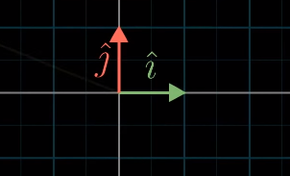
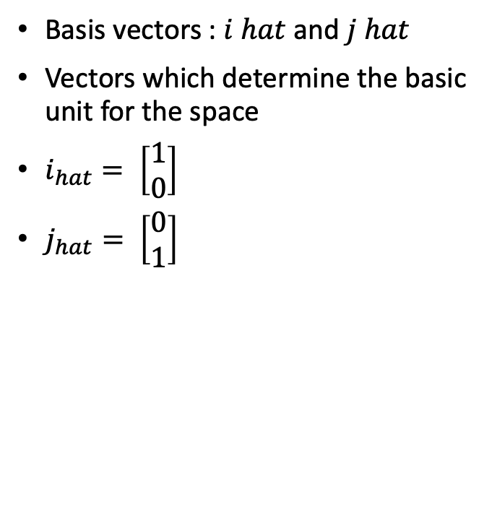
Basis Vectors
Basis vectors : $i hat$ and $j hat$
Vectors which determine the basic unit for the space
$i_{hat}= \left[\begin{aligned}1 \\ 0\end{aligned}\right]$
$j_{hat}= \left[\begin{aligned}0 \\ 1\end{aligned}\right]$

Slide 19
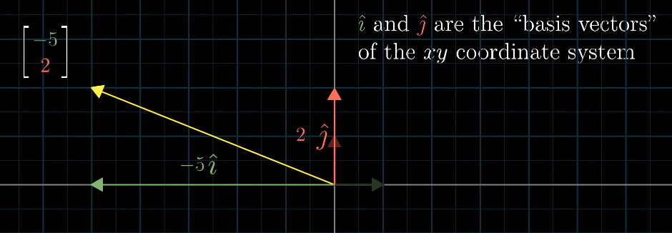
Linear Combinations
Any vector in 2D space can be expressed using these 2 vectors :

Slide 20
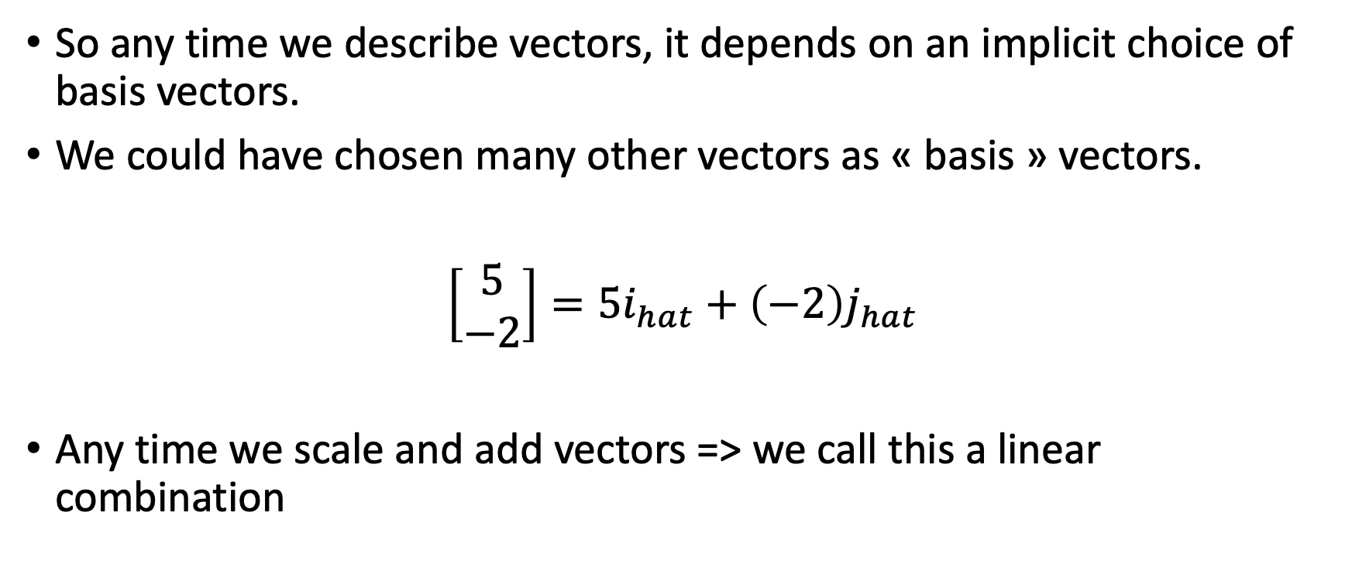
Linear Combinations
So any time we describe vectors, it depends on an implicit choice of basis vectors.
We could have chosen many other vectors as « basis » vectors.
$\left[\begin{aligned}5 \\ −2\end{aligned}\right]=5i_{hat}+\left(−2\right)j_{hat}$
Any time we scale and add vectors => we call this a linear combination

Slide 21
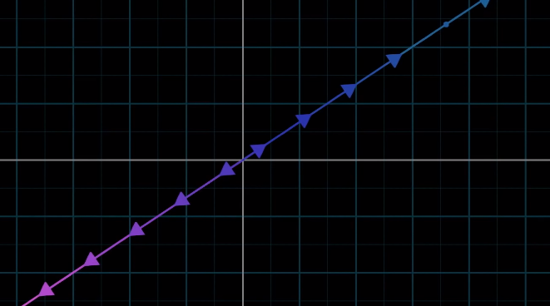
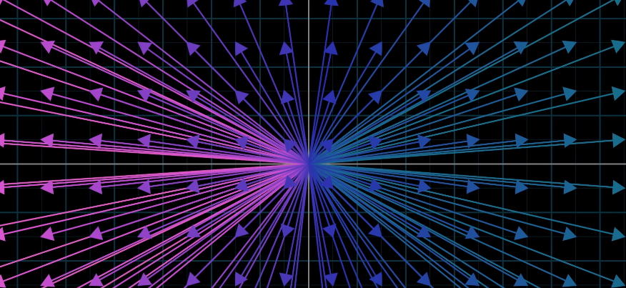
Span
Can reach any point in space by using linear combinations (barring certain specific cases where vectors are colinear or one of the vectors is the 0 vector)
This is called the span of 2 vectors, the amount of space they can cover basically.
In 2D : this can be
a line if the vectors are colinear
or a plane, ie all of the 2D space

Slide 22
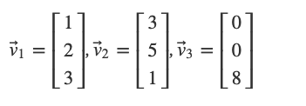
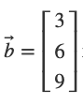
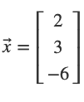
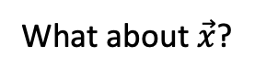
Mini exercise
Is the vector $\vec{b}$ a linear combination of the above vectors ?
What about $\vec{x}$?

Slide 23
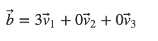
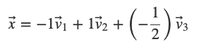
Solution

Slide 24
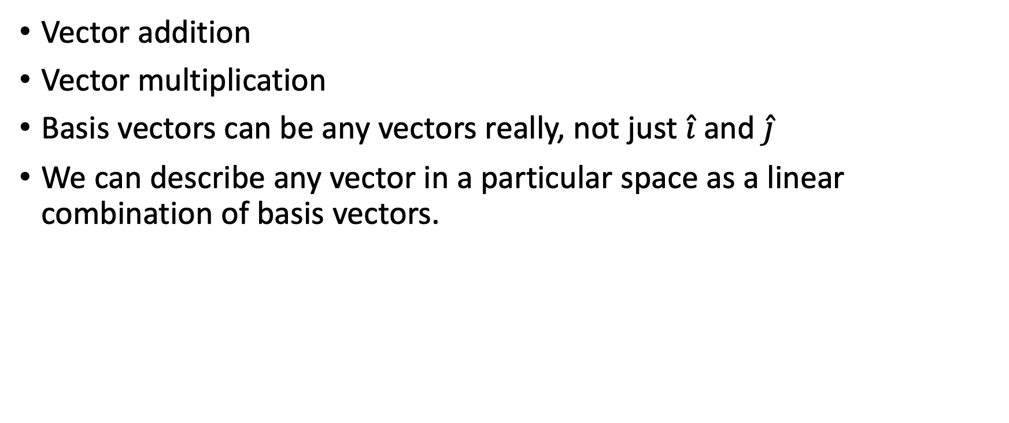
Quick Recap
Vector addition
Vector multiplication
Basis vectors can be any vectors really, not just $\hat{i}$and $\hat{j}$
We can describe any vector in a particular space as a linear combination of basis vectors.

Slide 25

Linear Transformations and Matrices
More intuitive to figure out what they do visually, so let’s try and do this

Slide 26
Get an intuition for
matrix / vector multiplication
and later on vector / vector multiplication or dot product
(so far we’ve only seen what happens when we multiply vectors by scalars)
Goal is to try and not rely on memorization for these operations which are the bread and butter of neural nets and are generally used in machine learning.

Slide 27
Transformation
Fancy word for function:
Takes an input and spits out an output
Vector 2 Vector in Linear Algebra
Transformation has maybe more of a visual connotation than function however…
If a transformation maps an input vector to an output vector, we can imagine that input vector moving over to the output vector.

Slide 28
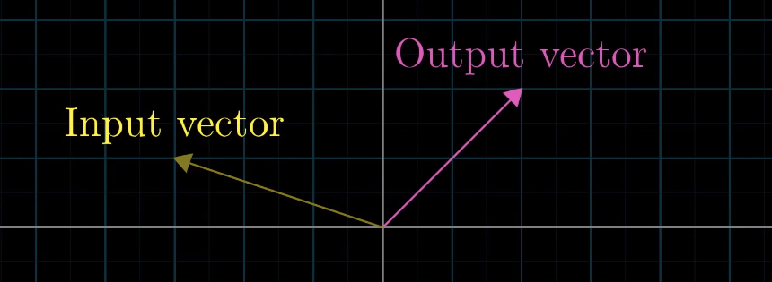


Illustration
For a single vector :
For every vector in the space (represented by an infinite grid):
=>

Slide 29
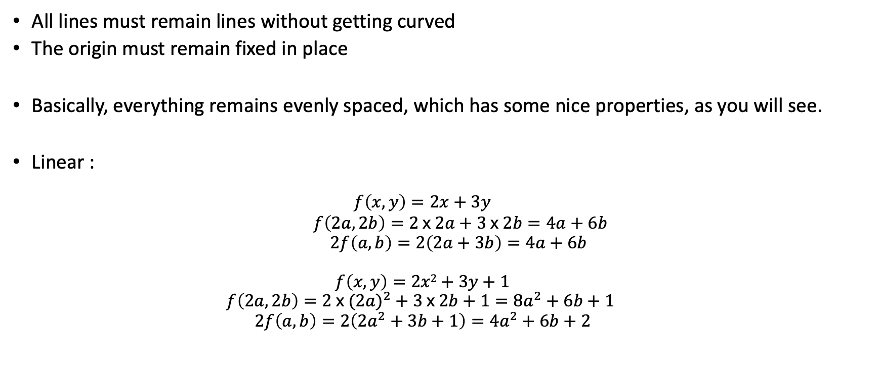
Linear (Transformation)
All lines must remain lines without getting curved
The origin must remain fixed in place
Basically, everything remains evenly spaced, which has some nice properties, as you will see.
Linear :
$$f\left(x,y\right)=2x+3y$$
$f\left(2a, 2b\right)=2 x 2a+3 x 2b=4a+6b$
$2f\left(a,b\right)=2\left(2a+3b\right)=4a+6b$
$$f\left(x,y\right)=2x2+3y+1$$
$$f\left(2a, 2b\right)=2 x (2{a)}^{2}+3 x 2b+1=8a^{2}+6b+1$$
$$2f\left(a,b\right)=2\left({2a}^{2}+3b+1\right)=4a^{2}+6b+2$$

Slide 30
Linear
Analogy :
If you and your friend work together and what you produce is the same as if you had been working seperately => linear
If you working 6h straight is paid the same as you working 1h on 6 different days => linear
And if the total is different from the sum of the parts => non-linear.

Slide 31
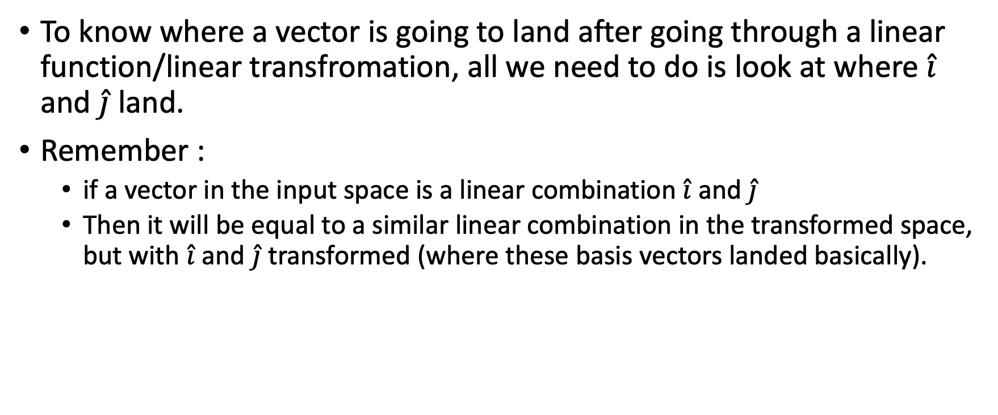
To know where a vector is going to land after going through a linear function/linear transfromation, all we need to do is look at where $\hat{i}$ and $\hat{j}$land.
Remember :
if a vector in the input space is a linear combination $\hat{i}$ and $\hat{j}$
Then it will be equal to a similar linear combination in the transformed space, but with $\hat{i}$ and $\hat{j}$transformed (where these basis vectors landed basically).

Slide 32
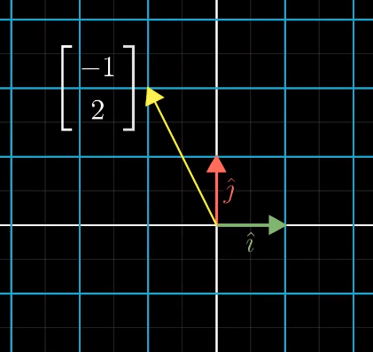
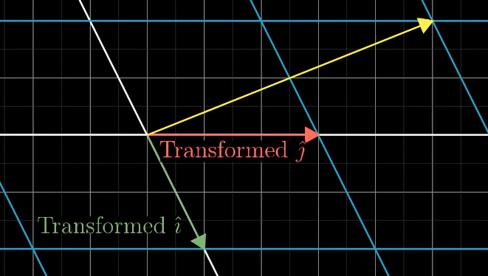
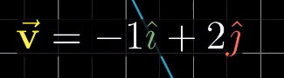
Example

Slide 33
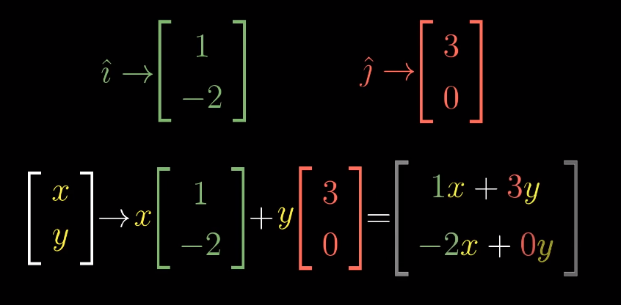
In the example, we see where the vector landed…
But by only looking at where the basis vectors land, we can deduce any transfromed vector’s new position.
So we basically only need these 2 new « basis » vectors :

Slide 34
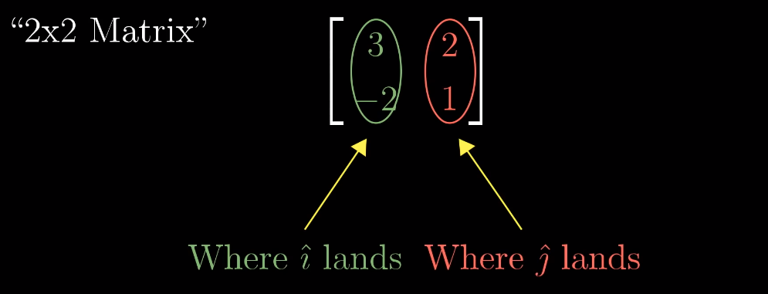
Matrices
We commonly package these coordinates into a 2x2 grid of numbers
=> a 2x2 Matrix

Slide 35
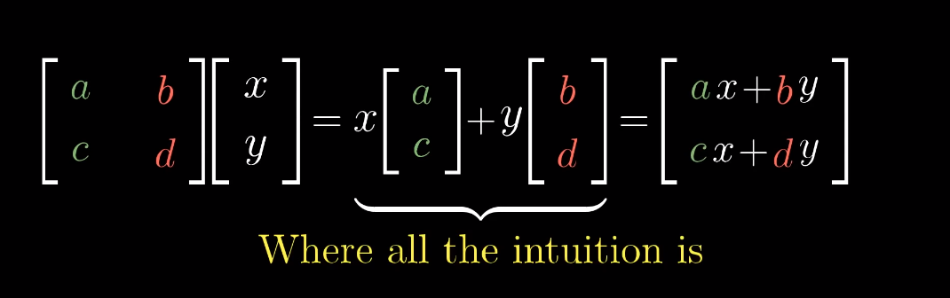
Generalized Formula of a Matrix / Vector Product
A matrix / vector product is like applying a function to a vector where:
The columns of the matrix are the transformed basis vectors
The result of the operation is a linear combination of those column vectors.
When learning about matrix vector products, seeing it as a linear combination is usually not made explicit… and you’re left with having to remember by heart ax + by etc…

Slide 36
Transformation examples
Rotation
90° for example
Shear
=> so everytime you see a matrix, you can interpret it as a certain transformation of space !

Slide 37
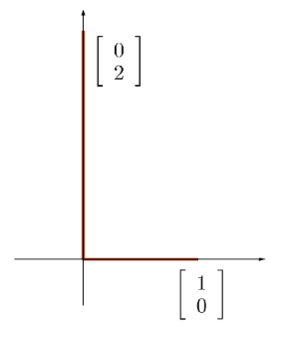
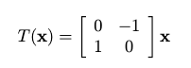
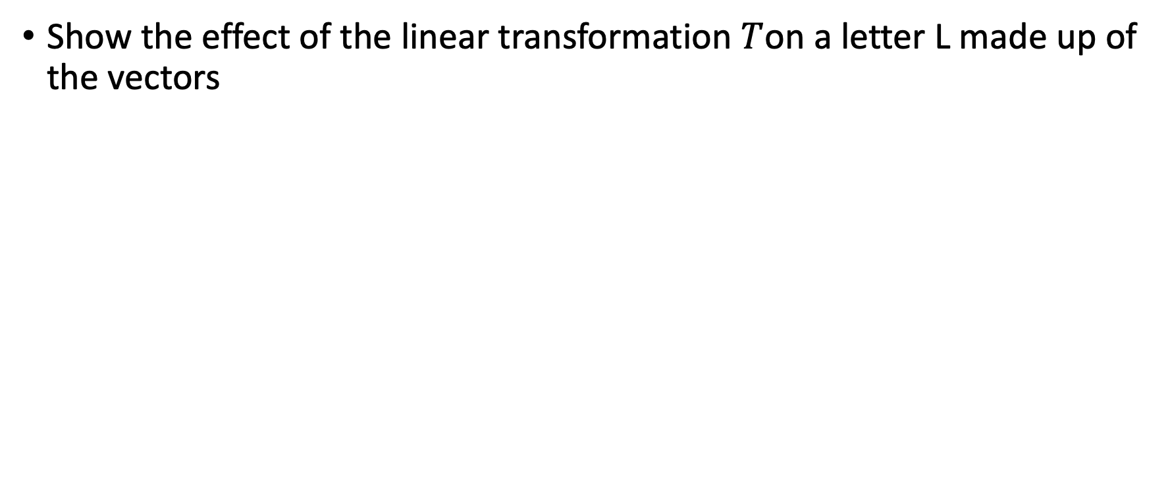
Exercise
Show the effect of the linear transformation $T$on a letter L made up of the vectors

Slide 38
Matrix Multiplication
What happens when we multiply 1 matrix by another ?
What does it mean intuitively, what happens ?
Always a good idea to think of the geometric meaning and not get lost in the numbers, especially at first !

Slide 39
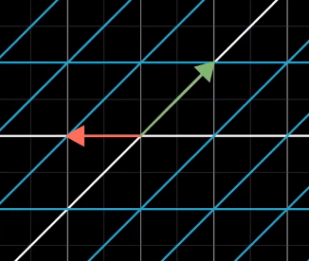
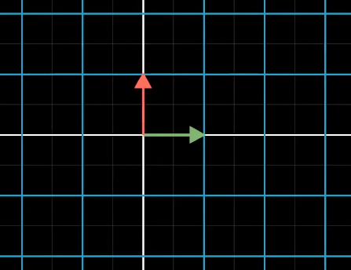
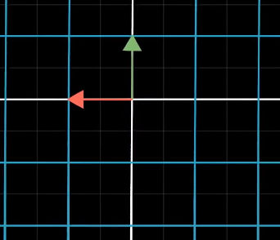
Matrix Multiplication
Apply one transformation to another: move space around twice !
The combined transformation is called a « composition »
Rotation then shear for example
=>
=>

Slide 40
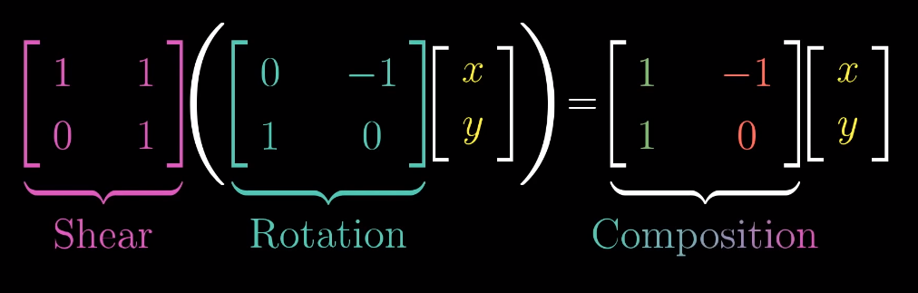

Slide 41
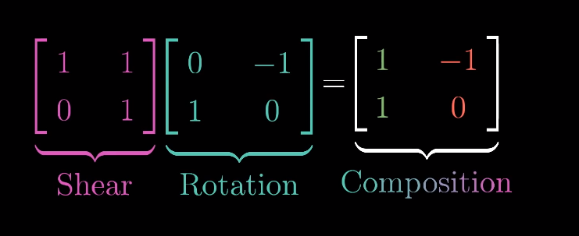
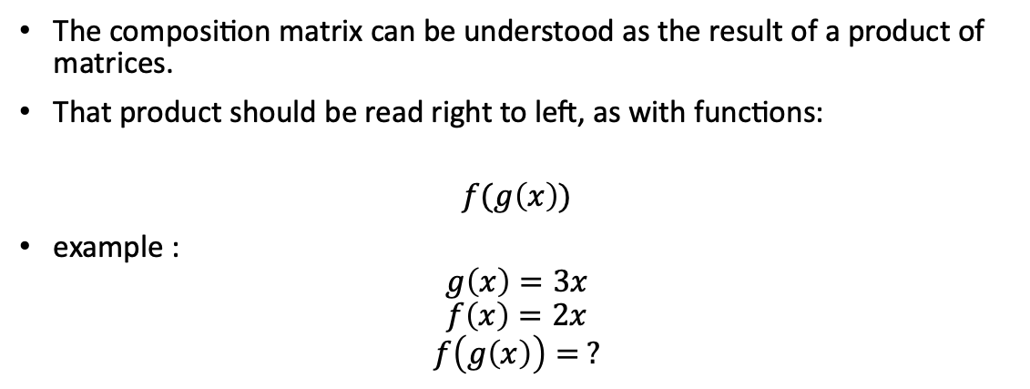
Matrix Multiplication
The composition matrix can be understood as the result of a product of matrices.
That product should be read right to left, as with functions:
$$f(g\left(x\right))$$
example :
$$g\left(x\right)=3x$$
$$f\left(x\right)=2x$$
$$f\left(g\left(x\right)\right)= ?$$

Slide 42
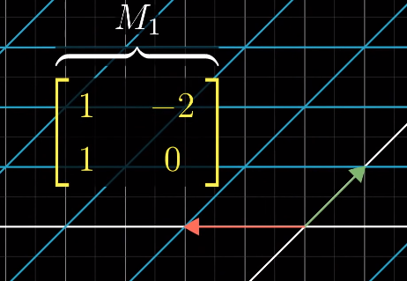

Example
We are going to apply 2 consecutive transformations, and follow the basis vectors:
Matrix $M_{1}$ and its transformation:

Slide 43



Example
Matrix $M_{2}$ and its transformation :

Slide 44

Example
Total effect gives us a new transformation !
Now let’s find it’s matrix…
… numerically,
without just following the vectors this time.

Slide 45


Example
First column of $M_{1}$tells us where $\hat{i}$ lands. Let’s follow this vector to begin with.

Slide 46


Example
To figure out what happens to this vector when we then apply the transformation defined by $M_{2}$,
we can use a simple matrix vector product, just like in the previous slides !

Slide 47

Example
And if you remember the intuition behind it,
This is nothing but a linear combination :

Slide 48

Mini Exercise
Now try and figure out the values in the second column of the matrix!

Slide 49

Example
Same thing as for the first column :

Slide 50


General formula
As previously, let’s first take care of $\hat{i}$ and its resulting transformation

Slide 51


General Formula
And then follow the same process for $\hat{j}$ !

Slide 52

General Formula
The final result :
It is very common to be taught this formula as something to memorize as a process…
Without anyone really ever going through where it comes from and what it represents.
Now this won’t be your case : you will have a much better conceptual framework for matrix / matrix multiplication

Slide 53

Practice
$E=\left[\begin{matrix}3 & 5 \\ −1 & 1\end{matrix}\right]$
$A= \left[\begin{matrix}−2 & 2 & 3 \\ 3 & 5 & −2\end{matrix}\right]$
Let $H=EA.$
$Find H.$
What about $AE ?$ Do you find the same composition ?

Slide 54

Extra Intuition
Now you know what this operation represents, here’s a question :
Does order matter ?

Slide 55



Comparison
Because you now understand what these matrices represent, it seems intuitive that those 2 transformations are not equal if you go through them in your head.
No need to go do calculations an compare the results !
$M_{1}M_{2}≠ M_{2}M_{1}$

Slide 56
Recap
Matrix matrix multiplication :
Consists in applying 1 transformation after another
The « product » of 2 matrices is called a « composition » and describes the combined, overall transformation.
Therefore the « product » of 2 matrices yields a new matrix.

Slide 57
Dot Product
Usually introduced as soon as vectors have been introduced, before matrices and transformations…
But it’s actually easier to understand why the dot product makes sense once you are familiar with transformations…

Slide 58

Standard view first
If you have 2 vectors with the same dimensions, then the dot product is equal to :
Summing the products of all the paired up coordinates.

Slide 59

Okay so what about…
$\left[\begin{aligned}1 \\ 2\end{aligned}\right]. \left[\begin{aligned}3 \\ 4\end{aligned}\right]$…?
$\left[\begin{aligned}1 \\ 2 \\ 3 \\ 4\end{aligned}\right]. \left[\begin{aligned}1 \\ 2 \\ 3 \\ 4\end{aligned}\right]$…?
What do you notice about the result ?

Slide 60


Geometric Interpretation
This often accompanies the dot product’s introduction.
Projecting $w$ onto the line which passes through the origin and $v$’s tip,
the dot product is equal to the length of that projection multiplied by the length of $v$.

Slide 61



A couple properties
The dot product between 2 vectors is :
< 0, when the projection faces the opposite direction
> 0, when vectors point in the same general direction
= 0 when perpendicular

Slide 62
Why does the geomatric representation make sense?
So can anyone make sense of the geometric representation ?
Why are we doing this ?
We can make sense of it by looking at this operation through the lense of linear transfromations…

Slide 63


Linear transformations from multiple dimensions to 1 dimension
So far, we’ve only seen matrix/vector products using square matrices and 2D vectors
But what happens when the shape of the matrix is rectangular…?
Going from this
To this

Slide 64

Multi-D to 1D
This type of transfromation is a function which takes in a vector and spits out some number
But this can’t be any function, must be linear

Slide 65

Linear ?
Let’s try and go over linearity again…
The definining mathematical properties for linearity :
$$f\left(a+b\right)=f\left(a\right)+f\left(b\right)$$
$$c ×f\left(a\right)=f(c×a)$$
But instead of verifying this every time… how can we try and understand visually if a transformation is linear ?

Slide 66


Linearity
1 good property to remember is:
If we have a line of evenly spaced dots (tips of vectors)
then those dots must remain evenly spaced if the transformation applied is linear !
In this case we have a transformation that goes from a 2d space to a 1d space.

Slide 67



VS. Non linear
Using a non-linear function :
We get this mapping
In matrix / vector form :
$\begin{matrix}[x & −y] \left[\begin{aligned}x \\ y\end{aligned}\right]\end{matrix}$

Slide 68



2D to 1D transformation
Remember, when applying a transformation, one of the transformations is completely determined by looking at where $\hat{i}$ and $\hat{j}$ land…
Now each basis vector just lands on a number vs. A point in 2D space.

Slide 69


Matrix
So when we record where these vectors land as the columns of the matrix
Each column just has a single number !
This is a 1 x 2 matrix ($ℝ^{1×2})$
(dimensions of the matrix)

Slide 70





Applying the transformation to a vector $v=\left[\begin{aligned}4 \\ 3\end{aligned}\right]$
The vector is defined as a linear combination of the basis vectors,
and a consequence of linearity is that
The same linear combination applies
Using where the basis vectors $\hat{i}$ and $\hat{j}$ land as « new basis vectors ».

Slide 71

Matrix / vector operation vs. Dot Product
Looking at things numerically, the matrix vector product in this case feels just like taking the dot product between 2 vectors !
Doesn’t this 1 x 2 matrix just look like a vector, tipped on its side ?

Slide 72


What about the projection of one vector onto another ?
One clever way to determine where $\hat{i} and \hat{j}$ land is to take a copy of the number line and embed it diagonally in 2D space.
Then add a 2D vector $\hat{u}$ whose tip sits on the number 1 on the number line.

Slide 73


Geometric Interpretation
$\hat{u}$ lives in the input space, it is just situated in such a way that it overlaps with the number line…
So now how do we find a 1 x 2 matrix which defines a transformation such that a vector is « translated » onto the number line (into 1D).
Need to find where $\hat{i} and \hat{j}$ each land…

Slide 74


Geometric Interpretation
Can reason by symmetry because these are both unit vectors:
Projecting $\hat{i}$ onto the line of numbers looks completely symmetric to projecting $\hat{u}$ onto the x axis…
So where does $\hat{i}$ land ? => Same place as $\hat{u}$ on the x axis ! This gives us
$$T\left(\hat{i}\right)= u_{x}$$
And similarly $T\left(\hat{j}\right)= u_{y}$

Slide 75

Geometric Interpretation
So the entries of the 2x1 matrix describing the transfromation are going to be the coordinates of $\hat{u}$…
There to translate any vector $\left[\begin{aligned}x \\ y\end{aligned}\right]$ onto the number line, we can just take its projection
ie. the sum of the projections of $\hat{i}$ and $\hat{j}$ scaled by $x and y$:
Input space : $x\hat{i}+y\hat{j}$
Output space : $x T\left(\hat{i}\right)+y T(\hat{j})$

Slide 76


Vector Norm
How can we calculate the length of a vector ?
$∥a∥ = \sqrt{a_{1}^{2}+a_{2}^{2}+…+a_{n}^{2}}$
Euclidian norm or L² norm
Measures the shortest distance rom the origin

Slide 77


Vector Norm
$∥a∥ =\left|a_{1}\right|+\left|a_{2}\right|+…+|a_{n}|$
L₁ norm or Manhattan norm
Sum of the absolute values of the components of the vector

Slide 78
Angle between vectors

